Slide 1
Program Design

Slide 2
Objectives
Students should understand the basic steps in the
programming process.
Students should understand the need for good design.
Students should be able to use the algorithm design
process to solve programming problems.
Students should be able to create activity diagrams and
pseudo-code.

Slide 3
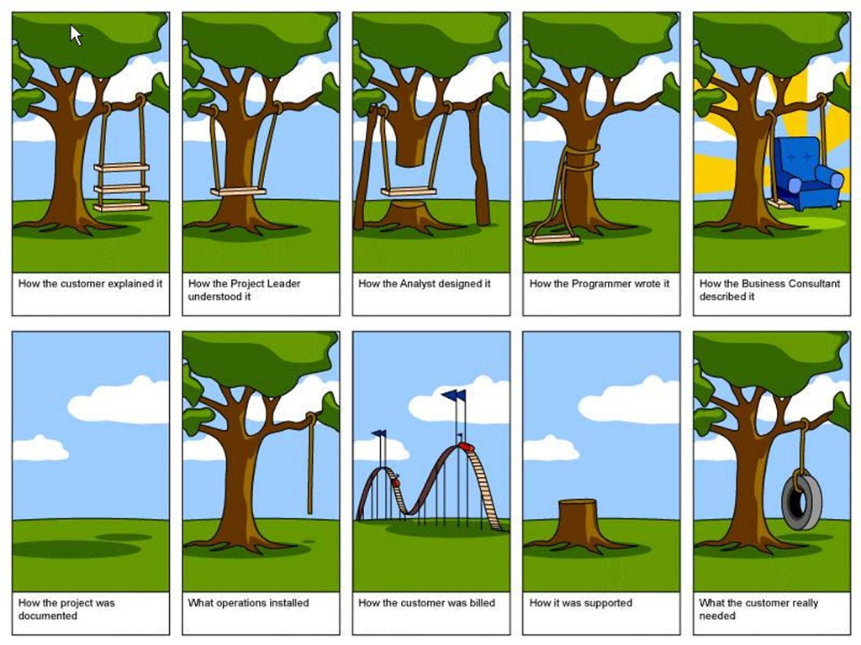

Slide 4
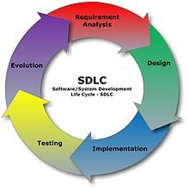

Slide 5
Let’s follow the process for
an example problem.

Slide 6
Requirements
Before you start to write code, you need to know
what problem you are trying to solve.
In this course that means reading the problem
description very carefully, and asking questions
when something is not clear. Making assumptions
when you are not sure can be dangerous.

Slide 7
Requirement
b
a
I have a robot that I want to move from position a
to position b. I want to move it on the most direct
route possible. Write the code that calculates how
to best move the robot to this new position.

Slide 8
Design
For a skilled programmer, the design phase is
often the most difficult step in the process. It requires
a lot of hard thinking about the problem to be solved.
A good programmer will spend much more time doing
design than they will actually writing the program.
Let’s think about the robot problem!

Slide 9
When designing an algorithm we often start
with a specific case. Once we solve this case
we can usually generalize the solution to other,
similar cases.
Let’s move the robot from the point 0,0
to the point 5,3.

Slide 10
To move to the new location,
We could run ahead 5 spaces
(5,3)
(0,0)

Slide 11
o
Then turn 90 and move ahead 3 spaces
(5,3)
(0,0)

Slide 12
But it would be faster to …

Slide 13
To make this move, we need to
* Calculate how much to turn, and
* Calculate how far to move

Slide 14
Looks like a right triangle
4
3
The path we want to take
2
1
1
2
3
4
5
6

Slide 15
How do we find the angle that we must turn the robot?
The path we want to take
4
6

Slide 16
We know the length of the side opposite the angle
and the length of the side adjacent to the angle.
-1
4
opposite
so … θ = tan
o
= 33.69
tan θ =
6
adjacent
?
4
θ
6

Slide 17
Now, how do we compute the distance to move?
?
4
θ
o
= 33.69
6

Slide 18
There are several ways we can do this. Let’s use
The Pythagorean theorem.
2
2
c = a + b
?
4
θ
o
= 33.69
6

Slide 19
There are several ways we can do this. Let’s use
The Pythagorean theorem.
2
2
=
16 + 36
c = a + b
?
=
52
4
= 7.211
θ
o
= 33.69
6

Slide 20
We have come up with the algorithm required!
Let’s write it down step by step.
Find out where we need to move to
Compute the angle to turn
3. Compute the distance to move
4. Move the robot

Slide 21
In order to write the program we need to break this
down into a sequence of smaller steps that we can
actually tell our program to do.

Slide 22
1. Find out where we need to move.
Ask the user to enter the x and y coordinate
of the point to move the robot to
b. Get these values from the user
c. Save them in variables side1 and side2

Slide 23
2. Compute the angle to turn
Given that side1 is the opposite side(rise)
b. And that side2 is the adjacent side (run)
c. Divide side1 by side2
d. Find the angle whose tangent = side1/side2

Slide 24
In most programming languages there are libraries
of mathematical functions to do things like
… find the angle whose tangent is a/b.

Slide 25
Microsoft provides an extensive set of resources
To help us with C# development. On the web,
Go to www.msdn.com

Slide 26
2. Compute the distance to move
a. Square the length of side1
b. Square the length of side2
c. Add them together
d. Take the square root of the result

Slide 27
When solving a programming problem like this,
we often draw an “Activity” diagram, to show
the steps of the program pictorially.

Slide 28
get lengths of
side1 and side2

Slide 29
get lengths of
side1 and side2
divide side1
by side2

Slide 30
get lengths of
side1 and side2
divide side1
by side2
find atan
side1 / side2

Slide 31
get lengths of
side1 and side2
divide side1
by side2
find atan
side1 / side2
square side1

Slide 32
get lengths of
side1 and side2
divide side1
by side2
find atan
side1 / side2
square side1
square side2

Slide 33
get lengths of
side1 and side2
divide side1
by side2
find atan
side1 / side2
square side1
square side2
add the
squares

Slide 34
get lengths of
side1 and side2
divide side1
by side2
find atan
side1 / side2
square side1
add the
squares
take the
square root
square side2

Slide 35
get lengths of
side1 and side2
divide side1
by side2
find atan
side1 / side2
square side1
add the
squares
take the
square root
print
results
square side2

Slide 36
You can also write down your algorithm design in
Pseudo-Code – English like phrases that describe
each step
Some additional detail has been added to make this
a complete program.

Slide 37
Declare some variables to hold user input
Tell the user what the program does
Ask the user to enter in values for a (height) and b (base)
Get these values and save in variables a and b
5. Divide a by b
6. Find arctangent of (a/b)
7. Square a
8. Square b
9. Add the squares of a and b
10. Take the square root of the result
11. Output the results, label output

Slide 38
Implementation.
Now we are ready to write the program. At this point
you should know enough C# to write this code, so some
of this may be a review for you.

Slide 39
We begin all programs with a file prologue.
The file prologue explains what is in the file.
// This program takes two values, and x and a y as real numbers
// The program computes the hypotenuse of a right triangle whose
// base is x and whose height is y. It also returns the angle between the base
// and the hypotenuse.
// Author: Joe Coder
// Course: CS 1400 section 002
// Date Last Modified: July 2, 2013
// Version 1.0

Slide 40
Next, we have to tell the compiler about
any namespaces that we will use. For all
Programs that we will write this semester
We will use the System namespace.
using System;

Slide 41
All of the code that we write in a C# program
will be enclosed in one or more classes. Initially
we will just use one class. Although we can name
this class anything that we want to, we will call
it Program. The code within a class is enclosed
in curly braces like this
class Program
{
. . .
}

Slide 42
Every C# program must include a method whose
name is “Main”. When your program runs, the
computer looks for the method named Main, and
begins execution at that point. Everything in the
Main method will be between a pair of curly braces.
static void Main( )
{
…
}

Slide 43
Before we write any code, we will paste our pseudo-code
in between the curly braces of Main, and mark each line
as a comment.
static void Main( )
{
// Declare some variables to hold our data
// Tell the user what the program does
// Ask the user to enter in values for height and base
// Get these values and save in variables height and base
// Divide height by base
// Find arctangent of (height/base)
// Square height
// Square base
// Add the squares of height and base
// Take the square root of the result
// Output the results, label output
}

Slide 44
Now, complete the program by adding the
C# code that implements each line of pseudo-code.

Slide 45
We have to declare any variables that we will use in this
program. We need A place in memory to hold the
length of each side of the triangle and a place to
hold the size of the angle.
// Declare some variables to hold our data
double width, height, hypotenuse, theta;
variable names
data type

Slide 46
The Atan method returns the size of an angle
in radians. We will need a constant to change
radians into degrees. We need to declare this
constant and set its value. The Math class
contains a constant for PI that we will use.
// declare a constant to do conversion
// from radians to degrees
const double CONVERSION_FACTOR = 180 /Math.PI;
C# statements all end in a semicolon.

Slide 47
Every program should start out by telling the user
What it is that the program will do.
The Console class represents the display on the computer.
The WriteLine method writes the text in quotation marks to the
display and moves to the next line.
// Tell the user what the program does
Console.WriteLine("This program moves a robot from the origin to");
Console.WriteLine("a point that you specify.");

Slide 48
This statement provides a user prompt. That is, they
help the user of the program know what to do next.
// Ask the user to enter in values for height and base
// Get these values and save in variables height and base
Console.Write("Please enter the x-coordinate of that point: ");

Slide 49
This statement gets the user’s input and saves it in the
variable named width.
The ReadLine method reads a string from the keyboard and returns
in-place of itself a temporary string variable. The double.Parse method
converts the string into a double which we save in the variable base.
// Ask the user to enter in values for height and width
// Get these values and save in variables height and width
Console.Write("Please enter in the base of the triangle: ");
width = double.Parse(Console.ReadLine( ) );

Slide 50
Now, prompt the user to type in the height of the
triangle and store it in the variable height.
Console.Write("Please enter the y-coordinate of that point: ");
height = double.Parse(Console.ReadLine( ) );

Slide 51
Do the calculations necessary to compute the angle.
Note how we signify multiplication and division.
multiply
// Divide height by width
// Find arctangent of (height/width)
theta = Math.Atan ( height / width) * CONVERSION_FACTOR;
divide

Slide 52
Now compute the hypotenuse.
// Square height
// Square width
// Add the squares of height and base
// Take the square root of the result
double square = (width * width) + (height * height);
hypotenuse = Math.Sqrt(square);

Slide 53
Display the results
// Output the results, label output
Console.WriteLine("The hypotenuse of the triangle is {0}", hypotenuse);
Console.WriteLine{"The angle between the hypotenuse and the base is {0:f2}", theta);
The {0:f2} is a placeholder.
The actual value of theta gets
put into this place when the
data is written to the console.
f2 means output the value as a decimal
number with 2 digits after the decimal
point.

Slide 54
This statements completes the program.
Console.ReadLine( );
This statement keeps the DOS console window open, until
the user presses the Enter key, so that the user can see
the program’s output.

Slide 55
Here is the complete program …
The comments have been removed in order to
get the entire program on one page.

Slide 56
// File Prologue …
using System;
class Program
{
static void Main()
{
double width, height, hypotenuse, theta;
const double CONVERSION_FACTOR = 180 / Math.PI;
Console.WriteLine("This program moves a robot from the origin to");
Console.WriteLine("a point that you specify.");
Console.Write("Please enter the x-coordinate of that point: ");
width = double.Parse(Console.ReadLine());
Console.Write("Please enter the y-coordinate of that point: ");
height = double.Parse(Console.ReadLine());
theta = Math.Atan(height / width) * CONVERSION_FACTOR;
hypotenuse = Math.Sqrt(width * width + height * height);
Console.WriteLine("Turn the robot {0:f2} degrees", theta);
Console.WriteLine("and move the robot {0:f2} units.", hypotenuse);
Console.ReadLine();
}//End Main()
}//End class Program

Slide 57
Desk Check the Code
Play the role of the computer. Go through
the code step by step and see if the results
at each step are correct and make sense.

Slide 58
// File Prologue …
using System;
class Program
{
static void Main()
{
double width, height, hypotenuse, theta;
const double CONVERSION_FACTOR = 180 / Math.PI;
Console.WriteLine("This program moves a robot from the origin to");
Console.WriteLine("a point that you specify.");
Console.Write("Please enter the x-coordinate of that point: ");
width = double.Parse(Console.ReadLine());
Console.Write("Please enter the y-coordinate of that point: ");
height = double.Parse(Console.ReadLine());
theta = Math.Atan(height / width) * CONVERSION_FACTOR;
hypotenuse = Math.Sqrt(width * width + height * height);
Console.WriteLine("Turn the robot {0:f2} degrees", theta);
Console.WriteLine("and move the robot {0:f2} units.", hypotenuse);
Console.ReadLine();
}//End Main()
}//End class Program
Write down the
variable names
width
height
hypotenuse
theta

Slide 59
Use a calculator
To check this
// File Prologue …
using System;
class Program
{
static void Main()
{
double width, height, hypotenuse, theta;
const double CONVERSION_FACTOR = 180 / Math.PI;
Console.WriteLine("This program moves a robot from the origin to");
Console.WriteLine("a point that you specify.");
Console.Write("Please enter the x-coordinate of that point: ");
width = double.Parse(Console.ReadLine());
Console.Write("Please enter the y-coordinate of that point: ");
height = double.Parse(Console.ReadLine());
theta = Math.Atan(height / width) * CONVERSION_FACTOR;
hypotenuse = Math.Sqrt(width * width + height * height);
Console.WriteLine("Turn the robot {0:f2} degrees", theta);
Console.WriteLine("and move the robot {0:f2} units.", hypotenuse);
Console.ReadLine();
}//End Main()
}//End class Program
conversionFactor
57.2957

Slide 60
// File Prologue …
using System;
class Program
{
static void Main()
{
double width, height, hypotenuse, theta;
const double CONVERSION_FACTOR = 180 / Math.PI;
Console.WriteLine("This program moves a robot from the origin to");
Console.WriteLine("a point that you specify.");
Console.Write("Please enter the x-coordinate of that point: ");
width = double.Parse(Console.ReadLine());
Console.Write("Please enter the y-coordinate of that point: ");
height = double.Parse(Console.ReadLine());
theta = Math.Atan(height / width) * CONVERSION_FACTOR;
hypotenuse = Math.Sqrt(width * width + height * height);
Console.WriteLine("Turn the robot {0:f2} degrees", theta);
Console.WriteLine("and move the robot {0:f2} units.", hypotenuse);
Console.ReadLine();
}//End Main()
}//End class Program
Write down the value
Let’s assume the user
types 3
width
height
?
?
hypotenuse
?
theta
?
conversionFactor
57.2957

Slide 61
// File Prologue …
using System;
class Program
{
static void Main()
{
double width, height, hypotenuse, theta;
const double CONVERSION_FACTOR = 180 / Math.PI;
Console.WriteLine("This program moves a robot from the origin to");
Console.WriteLine("a point that you specify.");
Console.Write("Please enter the x-coordinate of that point: ");
width = double.Parse(Console.ReadLine());
Console.Write("Please enter the y-coordinate of that point: ");
height = double.Parse(Console.ReadLine());
theta = Math.Atan(height / width) * CONVERSION_FACTOR;
hypotenuse = Math.Sqrt(width * width + height * height);
Console.WriteLine("Turn the robot {0:f2} degrees", theta);
Console.WriteLine("and move the robot {0:f2} units.", hypotenuse);
Console.ReadLine();
}//End Main()
}//End class Program
Write down the value
Let’s assume the user
types 3
width
height
?
3
hypotenuse
?
theta
?
conversionFactor
57.2957

Slide 62
// File Prologue …
using System;
class Program
{
static void Main()
{
double width, height, hypotenuse, theta;
const double CONVERSION_FACTOR = 180 / Math.PI;
Console.WriteLine("This program moves a robot from the origin to");
Console.WriteLine("a point that you specify.");
Console.Write("Please enter the x-coordinate of that point: ");
width = double.Parse(Console.ReadLine());
Console.Write("Please enter the y-coordinate of that point: ");
height = double.Parse(Console.ReadLine());
theta = Math.Atan(height / width) * CONVERSION_FACTOR;
hypotenuse = Math.Sqrt(width * width + height * height);
Console.WriteLine("Turn the robot {0:f2} degrees", theta);
Console.WriteLine("and move the robot {0:f2} units.", hypotenuse);
Console.ReadLine();
}//End Main()
}//End class Program
Write down the value
Let’s assume the user
types 4
width
height
3
4
hypotenuse
theta
conversionFactor
57.2957

Slide 63
// File Prologue …
using System;
class Program
{
static void Main()
{
double width, height, hypotenuse, theta;
const double CONVERSION_FACTOR = 180 / Math.PI;
Console.WriteLine("This program moves a robot from the origin to");
Console.WriteLine("a point that you specify.");
Console.Write("Please enter the x-coordinate of that point: ");
width = double.Parse(Console.ReadLine());
Console.Write("Please enter the y-coordinate of that point: ");
height = double.Parse(Console.ReadLine());
theta = Math.Atan(height / width) * CONVERSION_FACTOR;
hypotenuse = Math.Sqrt(width * width + height * height);
Console.WriteLine("Turn the robot {0:f2} degrees", theta);
Console.WriteLine("and move the robot {0:f2} units.", hypotenuse);
Console.ReadLine();
}//End Main()
}//End class Program
Check this with a
calculator
width
height
3
4
hypotenuse
theta
36.869
conversionFactor
57.2957
square

Slide 64
// File Prologue …
using System;
class Program
{
static void Main()
{
double width, height, hypotenuse, theta;
const double CONVERSION_FACTOR = 180 / Math.PI;
Console.WriteLine("This program moves a robot from the origin to");
Console.WriteLine("a point that you specify.");
Console.Write("Please enter the x-coordinate of that point: ");
width = double.Parse(Console.ReadLine());
Console.Write("Please enter the y-coordinate of that point: ");
height = double.Parse(Console.ReadLine());
theta = Math.Atan(height / width) * CONVERSION_FACTOR;
hypotenuse = Math.Sqrt(width * width + height * height);
Console.WriteLine("Turn the robot {0:f2} degrees", theta);
Console.WriteLine("and move the robot {0:f2} units.", hypotenuse);
Console.ReadLine();
}//End Main()
}//End class Program
Check this with a
calculator
width
height
3
4
hypotenuse
theta
conversionFactor
57.2957
Square
25

Slide 65
// File Prologue …
using System;
class Program
{
static void Main()
{
double width, height, hypotenuse, theta;
const double CONVERSION_FACTOR = 180 / Math.PI;
Console.WriteLine("This program moves a robot from the origin to");
Console.WriteLine("a point that you specify.");
Console.Write("Please enter the x-coordinate of that point: ");
width = double.Parse(Console.ReadLine());
Console.Write("Please enter the y-coordinate of that point: ");
height = double.Parse(Console.ReadLine());
theta = Math.Atan(height / width) * CONVERSION_FACTOR;
hypotenuse = Math.Sqrt(width * width + height * height);
Console.WriteLine("Turn the robot {0:f2} degrees", theta);
Console.WriteLine("and move the robot {0:f2} units.", hypotenuse);
Console.ReadLine();
}//End Main()
}//End class Program
Check this with a
calculator
width
height
3
4
hypotenuse
theta
5
36.869
conversionFactor
57.2957
square
25

Slide 66
Test the program with the values used
in the desk check. Does it produce the
same answers?

Slide 67
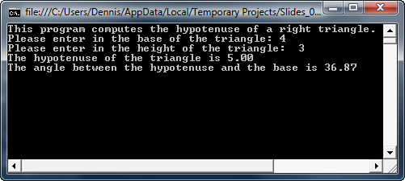

Slide 68
Summary of what we did
1. We analyzed the problem to be solved
a. Gather information – write down what you know
b. Write down what you need to find out
c. Write down the steps to get from a to b, in detail
2. Draw an activity diagram
3. Write the code
4. Desk check your code – fix it if necessary (refactor)
5. Compile your code – fix compiler errors (refactor)
6. Test your code – fix it if necessary (refactor)

Slide 69
Another Example

Slide 70
An Electrical Engineering Problem
Ohm’s law states that the voltage across
a resistor is equal to the current through
the resistor times the value of the resistance,
or …
v = i * R

Slide 71
Furthermore, if two or more resistors are
connected in series, the equivalent resistance
is equal to the sum of the individual resistances.
R_{eq} = R₁ + R₂ + … R_{n}

Slide 72
Consider the following circuit:
2Ω
8Ω
12A
Develop a program that will compute the
voltage drop across the two resistors.
Allow the user to specify the values for the
resistors and the current.

Slide 73
Analyze the problem –
Write down what you know
Write down what you want to find out
2. Write down the steps involved in the program
2. Draw an activity diagram
3. Based on the previous example, see if you can
write the code that will solve this problem.

Slide 74
Remember the basic structure of a C# Program
// file prologue
using System;
class Program
{
// declare constants
static void Main( )
{
// declare local variables
// prompt the user for input
// get input
// calculate the answer
// output the answer
}//End Main()
}//End class Program

Slide 75
Another Example

Slide 76
A directly connected telephone service is one in
which each telephone is directly connected to
every other telephone in the system. There is no
central switching station.
telephone #1
telephone #2
telephone #3
telephone #4
The number of lines required to connect n telephones = n (n-1)/2.

Slide 77
Write a program that computes the number of
lines required to connect n telephones, where
the user supplies the value of n.

Slide 78
Analyze the problem –
Write down what you know
Write down what you want to find out
2. Write down the steps involved in the program
2. Draw an activity diagram
3. Based on the previous example, see if you can
write the code that will solve this problem.

Slide 79
Remember the basic structure of a C# Program
// file prologue
using System;
class Program
{
// declare constants
static void Main( )
{
// declare local variables
// prompt the user for input
// get input
// calculate the answer
// output the answer
}//End Main()
}//End class Program

Slide 80
Another Example

Slide 81
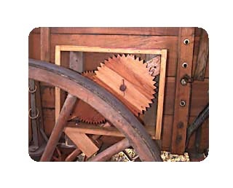
When the Mormon pioneers crossed the plains. The
built a simple odometer to help them figure out how
far they traveled each day.
The idea is simple: just count the number of times the wheel rotates,
and then given the size of the wheel you can determine how far you
traveled.

Slide 82
Write a program that, given the diameter of a wagon wheel,
will compute the number of rotations the wheel would make
in one mile.

Slide 83
Analyze the problem –
Write down what you know
Write down what you want to find out
2. Write down the steps involved in the program
2. Draw an activity diagram
3. Based on the previous example, see if you can
write the code that will solve this problem.

Slide 84
Remember the basic structure of a C# Program
// file prologue
using System;
class Program
{
// declare constants
static void Main( )
{
// declare local variables
// prompt the user for input
// get input
// calculate the answer
// output the answer
}//End Main()
}//End class Program

